Slide 1


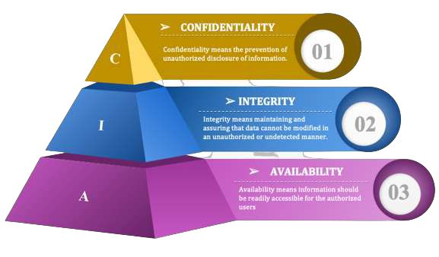
Session 4
Cyber Security - CIA Triad Model

Slide 2
Learning Outcomes
Define the CIA Triad
What are the 3 components of the CIA triad?
Why is the CIA triad important?
Objectives that should be kept in mind while securing a network
Best practices for implementing the CIA triad

Slide 3
What is the CIA triad (confidentiality, integrity and availability)?
The CIA triad refers to confidentiality, integrity and availability, describing a model designed to guide policies for information security (infosec) within an organization. The model is sometimes referred to as the AIC triad -- which stands for availability, integrity and confidentiality -- to avoid confusion with the Central Intelligence Agency.
In this context, confidentiality is a set of high-level rules that limits access to all types of data and information. Integrity is the assurance that the information is trustworthy and accurate. And availability is a form of risk management to guarantee reliable access to that information by authorized people.

Slide 4
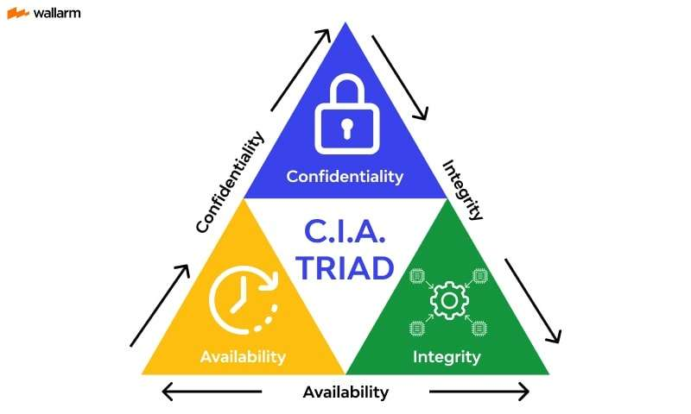
CIA triad (confidentiality, integrity and availability)?

Slide 5
What are the 3 components of the CIA triad?
The following is a breakdown of the components of the CIA triad:
Confidentiality. Roughly equivalent to privacy, confidentiality measures are designed to prevent sensitive information from unauthorized access attempts. It's common for data to be classified according to the amount and type of damage that could be done if it fell into the wrong hands. More or less stringent data security measures can then be implemented according to those categories.
Integrity. The consistency, accuracy and trustworthiness of data must be maintained over its entire lifecycle. Data must not be changed in transit, and steps must be taken to ensure it can't be altered by unauthorized people -- for example, in data breaches.
Availability. Information should be consistently and readily accessible for authorized parties. This involves properly maintaining hardware and technical infrastructure and systems that hold and display the information.

Slide 6
Why is the CIA triad important?
Each letter in the CIA triad represents a foundational principle in cybersecurity. The importance of the security model speaks for itself: Confidentiality, integrity and availability are considered the three most important concepts in infosec.
Considering these three principles together within the triad framework guides the development of security policies for organizations. When evaluating needs and use cases for potential new products and technologies, the triad helps organizations ask focused questions about how value is being provided in those three key areas

Slide 7
These are the objectives that should be kept in mind while securing a network.
Confidentiality
Confidentiality means that only authorized individuals/systems can view sensitive or classified information. The data being sent over the network should not be accessed by unauthorized individuals. The attacker may try to capture the data using different tools available on the Internet and gain access to your information. A primary way to avoid this is to use encryption techniques to safeguard your data so that even if the attacker gains access to your data, he/she will not be able to decrypt it. Encryption standards include AES(Advanced Encryption Standard) and DES (Data Encryption Standard). Another way to protect your data is through a VPN tunnel. VPN stands for Virtual Private Network and helps the data to move securely over the network.

Slide 8
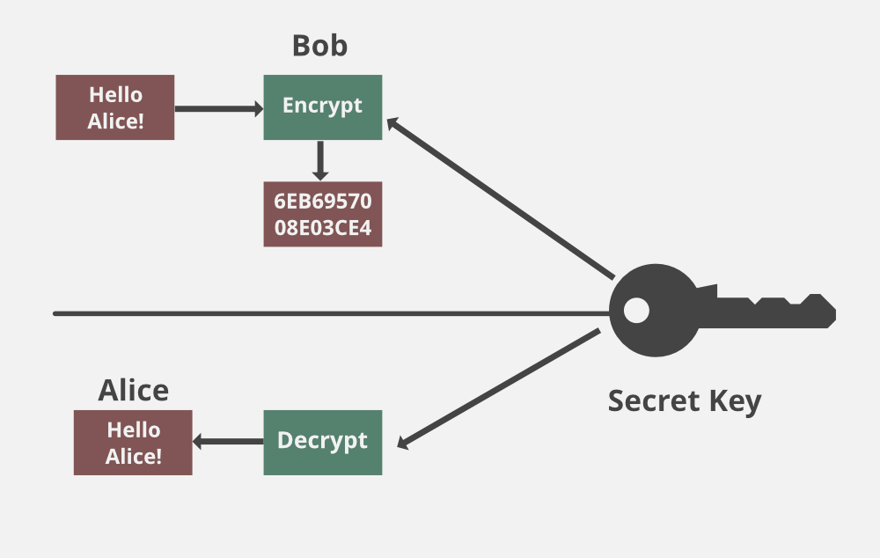
These are the objectives that should be kept in mind while securing a network.
Confidentiality

Slide 9
These are the objectives that should be kept in mind while securing a network.
Integrity
The next thing to talk about is integrity. Well, the idea here is to make sure that data has not been modified. Corruption of data is a failure to maintain data integrity. To check if our data has been modified or not, we make use of a hash function. We have two common types: SHA (Secure Hash Algorithm) and MD5(Message Direct 5). Now MD5 is a 128-bit hash and SHA is a 160-bit hash if we’re using SHA-1. There are also other SHA methods that we could use like SHA-0, SHA-2, and SHA-3.
Let’s assume Host ‘A’ wants to send data to Host ‘B’ to maintain integrity. A hash function will run over the data and produce an arbitrary hash value H1 which is then attached to the data. When Host ‘B’ receives the packet, it runs the same hash function over the data which gives a hash value of H2. Now, if H1 = H2, this means that the data’s integrity has been maintained and the contents were not modified.

Slide 10
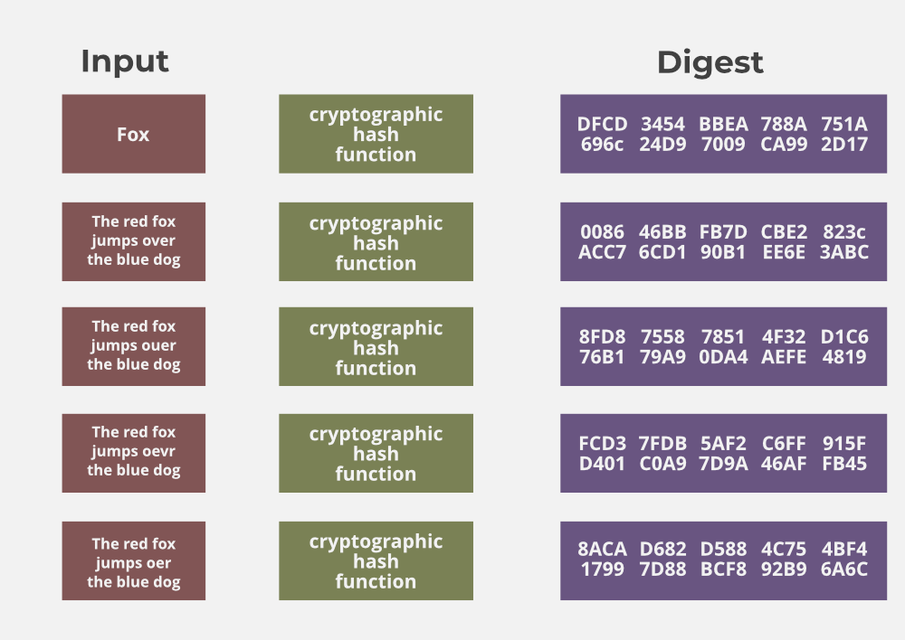
These are the objectives that should be kept in mind while securing a network.
Integrity

Slide 11
These are the objectives that should be kept in mind while securing a network.
Availability
This means that the network should be readily available to its users. This applies to systems and to data. To ensure availability, the network administrator should maintain hardware, make regular upgrades, have a plan for failover, and prevent bottlenecks in a network. Attacks such as DoS or DDoS may render a network unavailable as the resources of the network get exhausted. The impact may be significant to the companies and users who rely on the network as a business tool. Thus, proper measures should be taken to prevent such attacks.

Slide 12
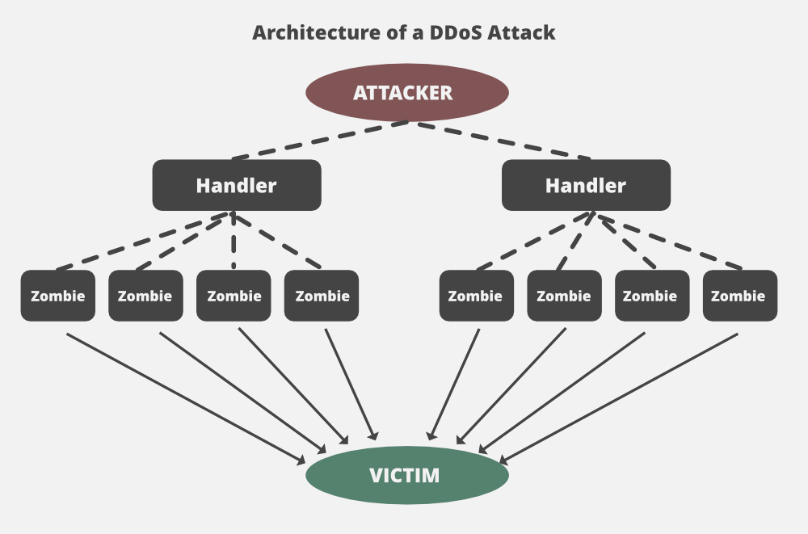
These are the objectives that should be kept in mind while securing a network.
Availability

Slide 13
Best practices for implementing the CIA triad
In implementing the CIA triad, an organization should follow a general set of best practices. These can be divided into the three subjects and include the following:
Confidentiality
Follow an organization’s data-handling security policies.
Use encryption and 2FA
Keep access control lists and other file permission up to date.
2. Integrity
Ensure employees are knowledgeable about compliance and regulatory requirements to minimize human error.
Use backup and recovery software and services
Use version control, access control, security control, data logs and checksums.

Slide 14
Best practices for implementing the CIA triad
3. Availability
Use preventive measures such as redundancy, failover and RAID.
Ensure systems and application stay updated.
Use network or server monitoring systems.
Have a data recovery and business continuity plan in place in case of data loss.

Slide 15
PYTHON PRACTICAL ACTIVITY ( Code Link )
Practical Activity # 1 (Confidentiality – AES Encryption Simulator)
Practical Activity # 2 (Integrity – Hash Comparison Using SHA-256)
Practical Activity # 3 (Availability – DoS Attack Load Simulation)
Practical Activity # 4 (CIA Principle Validator)
Practical Activity # 5 (Integrity + Confidentiality – Secure File Storage)

Slide 16
Practical Activity # 1 (Confidentiality – AES Encryption Simulator)
🔐 Demonstrates how encryption maintains confidentiality by hiding original data from unauthorized viewers.
from Crypto.Cipher import AES
import base64
def pad(text):
return text + (16 - len(text) % 16) * ' '
key = b'Sixteen byte key'
cipher = AES.new(key, AES.MODE_ECB)
message = input("Enter a message to encrypt: ")
padded_msg = pad(message)
ciphertext = cipher.encrypt(padded_msg.encode())
encoded = base64.b64encode(ciphertext).decode()
print(f"🔒 Encrypted Message: {encoded}")
# Decryption
decoded = base64.b64decode(encoded)
plaintext = cipher.decrypt(decoded).decode().strip()
print(f"🔓 Decrypted Message: {plaintext}")

Slide 17
Practical Activity # 2 (Integrity – Hash Comparison Using SHA-256)
🔐 Explains how hashing ensures data has not been altered.
import hashlib
def hash_data(data):
return hashlib.sha256(data.encode()).hexdigest()
data1 = input("Enter original message: ")
data2 = input("Enter received message: ")
hash1 = hash_data(data1)
hash2 = hash_data(data2)
print(f"Hash 1: {hash1}")
print(f"Hash 2: {hash2}")
if hash1 == hash2:
print("✅ Data integrity maintained. No tampering detected.")
else:
print("❌ Data integrity compromised! The message has changed.")

Slide 18
Practical Activity # 3 (Availability – DoS Attack Load Simulation)
🔐 Mimics a Denial-of-Service scenario to show what happens when a server gets flooded.
import time
print("📡 Simulating fake requests to a service...")
for i in range(1, 101):
time.sleep(0.05) # Simulate delay
print(f"Request #{i}: Service under load...")
print("⚠️ Service temporarily unavailable due to high traffic!")

Slide 19
Practical Activity # 4 (CIA Principle Validator)
🔐 Tests user understanding of which principle applies in given scenarios.
questions = {
"Encrypting student report cards so only parents can view them protects:": "confidentiality",
"Verifying downloaded software hasn’t been tampered with protects:": "integrity",
"Using cloud backups to ensure data is always retrievable supports:": "availability",
}
score = 0
for q, correct in questions.items():
ans = input(q + "\n> ").strip().lower()
if ans == correct:
print("✅ Correct!")
score += 1
else:
print(f"❌ Incorrect. Correct answer: {correct}\n")
print(f"\n🎓 Final Score: {score}/{len(questions)}")

Slide 20
Practical Activity # 5 (Integrity + Confidentiality – Secure File Storage)
🔐 Uses both AES and hashing to store a file securely and verify it hasn’t changed.
from Crypto.Cipher import AES
import hashlib
import base64
def pad(msg): return msg + (16 - len(msg) % 16) * ' '
key = b'Sixteen byte key'
cipher = AES.new(key, AES.MODE_ECB)
data = input("Enter data to store securely: ")
encrypted = cipher.encrypt(pad(data).encode())
hash_val = hashlib.sha256(data.encode()).hexdigest()
# Store encrypted + hash
print("\n📝 Data stored securely:")
print("Encrypted (base64):", base64.b64encode(encrypted).decode())
print("SHA-256 Hash:", hash_val)

Slide 21


Exercise
1. What is the main purpose of the CIA Triad in cybersecurity? A) To describe cloud storage models B) To guide information security policies C) To implement biometric access D) To restrict system updates Answer: B
2. What does the 'C' in CIA Triad stand for? A) Control B) Confidentiality C) Connectivity D) Certification Answer: B

Slide 22
Exercise
3. Which principle ensures that data has not been tampered with during transmission? A) Confidentiality B) Integrity C) Availability D) Authenticity Answer: B
4. What is a common technique used to maintain confidentiality in data transmission? A) Using strong passwords B) Performing hash comparisons C) Implementing encryption protocols D) Monitoring login activity Answer: C
5. How does the concept of availability support cybersecurity? A) By reducing user login time B) By ensuring authorized users can access data when needed C) By blocking external data sources D) By hiding system vulnerabilities Answer: B

Slide 23
Quiz
Now it’s time to put your knowledge to the test! Click the link below to access an interactive quiz in the Streamlit app that will challenge you on the Core Principles of Information Security: Confidentiality, Integrity, and Availability (CIA Triad).
How to Approach the Quiz:
Understand each principle: Pay attention to how each element of the Triad applies to real-world scenarios.
Select your answers thoughtfully: Choose the response that best reflects the principles you’ve learned.
Test your grasp: The goal is to think critically about how these concepts protect information in various situations.
Click here to begin the quiz! https://session-4-cia.streamlit.app/

